Slide 1

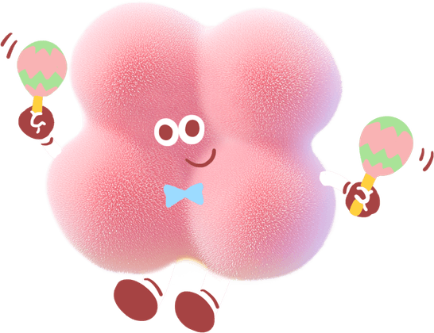
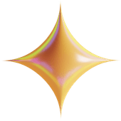
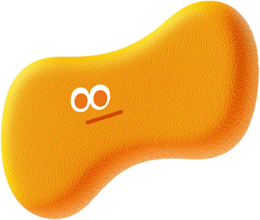
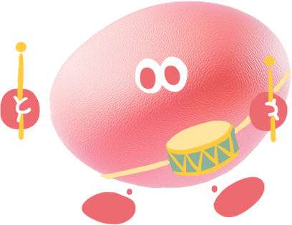
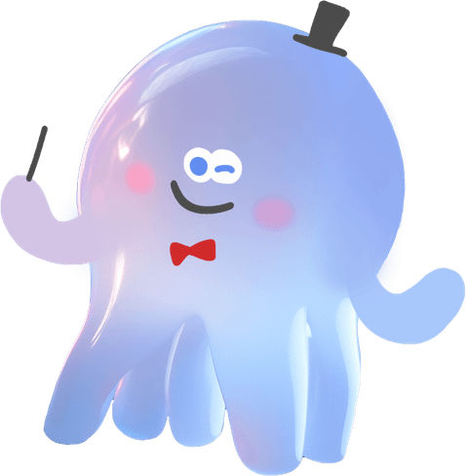

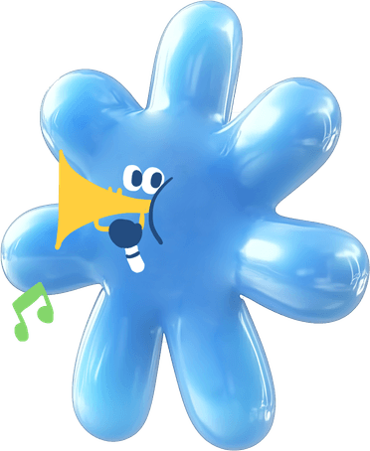

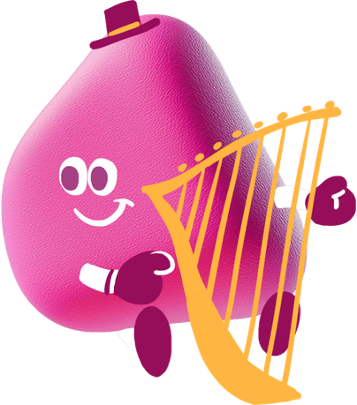
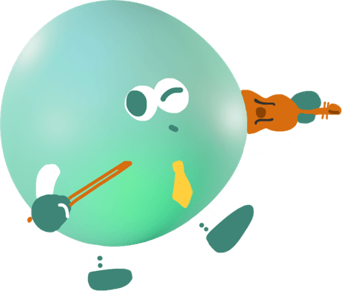
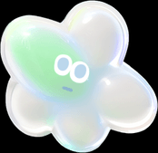
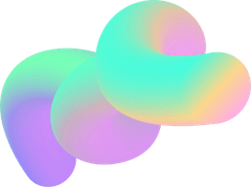
AI-Powered Music Maker
Sean Wong
2025/01/01

Slide 2

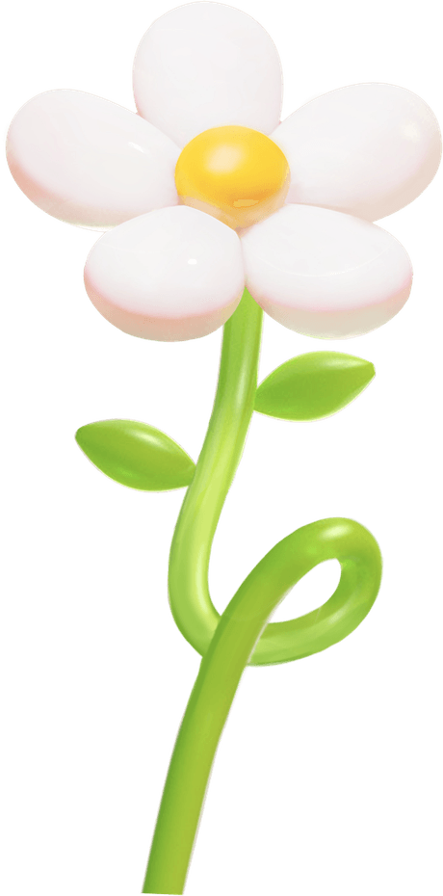


CONTENT
1
AI & the Artist
2
Create & Compose
3
Produce & Design
4
Practice & Perform
5
Brand & Promote
6
Workflow Audit

Slide 3

CONTENT
1
2
Practice Labs
Ethics & Recap

Slide 4

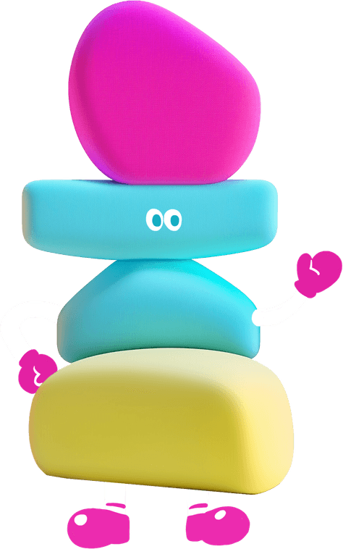

01
PART
AI & the Artist

Slide 5

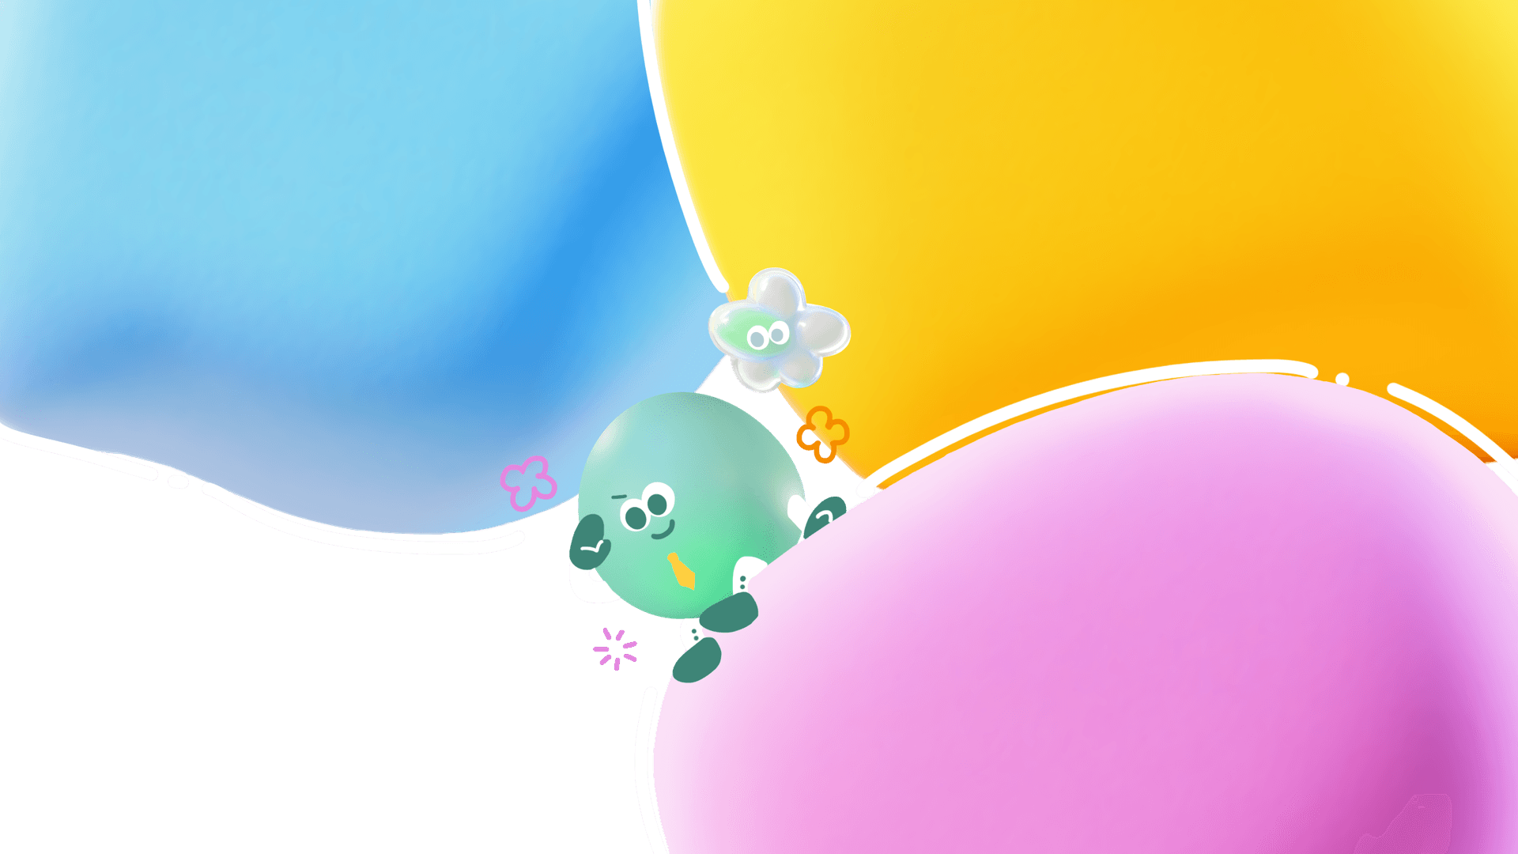

Enhance Creativity
Reduce Repetitive Friction
AI provides new tools for songwriting and sound design, offering fresh ideas and expanding the creative possibilities for artists.
AI streamlines repetitive tasks like audio editing and transcription, freeing musicians to focus on creative expression and performance.
Maintain Artistic Control
Why AI Matters for Musicians
Musicians retain full creative control, using AI as a tool to enhance their unique voice and artistic vision without replacement.

Slide 6
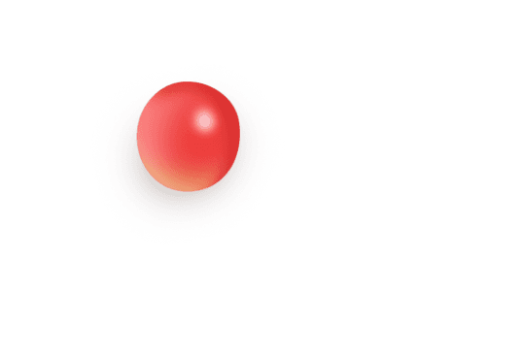
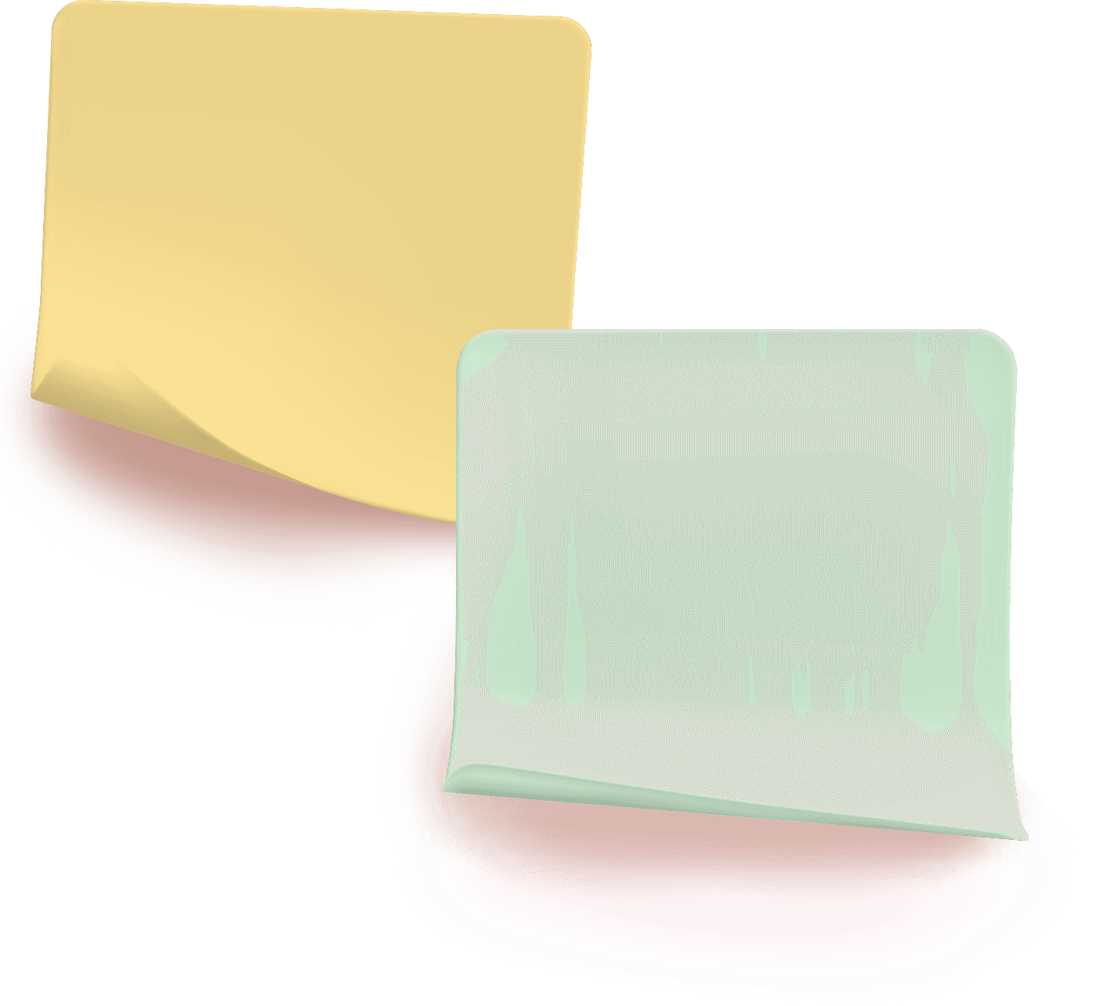
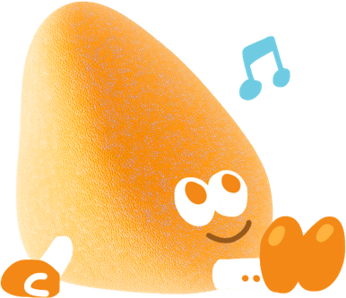
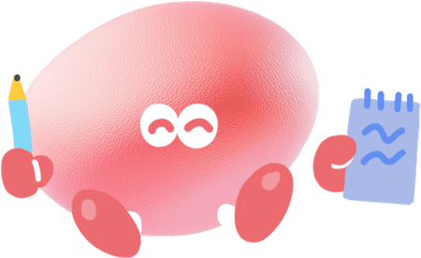
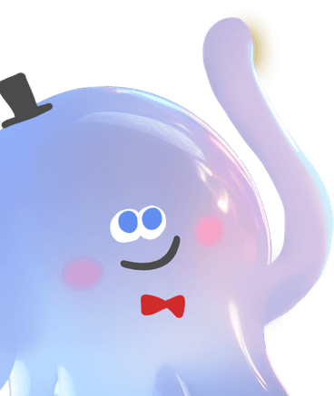
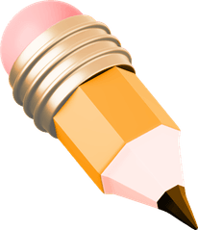

Musical Tasks AI Handles Best
High-Friction Duties
AI excels at tasks like chord generation, lyric drafting, noise cleanup, and auto-mixing, which are often time-consuming and repetitive.
Human-Only Zones
Artistic decisions, expressive playing, improvisation, and ethical considerations remain firmly in the hands of the musician.

Slide 7
02
PART
Create & Compose

Slide 8
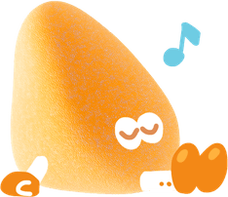

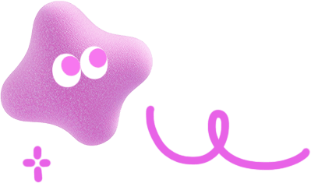
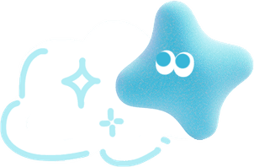
AI Songwriting Acceleration
Chord Progressions
Full Arrangements
Melody Hooks
DAW Integration
AI algorithms quickly generate chord progressions, providing a foundation for songwriting and composition.
AI assists in developing full song arrangements, turning initial ideas into more complex and complete compositions.
AI can create catchy melody hooks, helping musicians break through writer’s block and spark new ideas.
Tools like Logic Pro and Ableton Live offer AI-assisted composition features, seamlessly integrating with existing workflows.

Slide 9
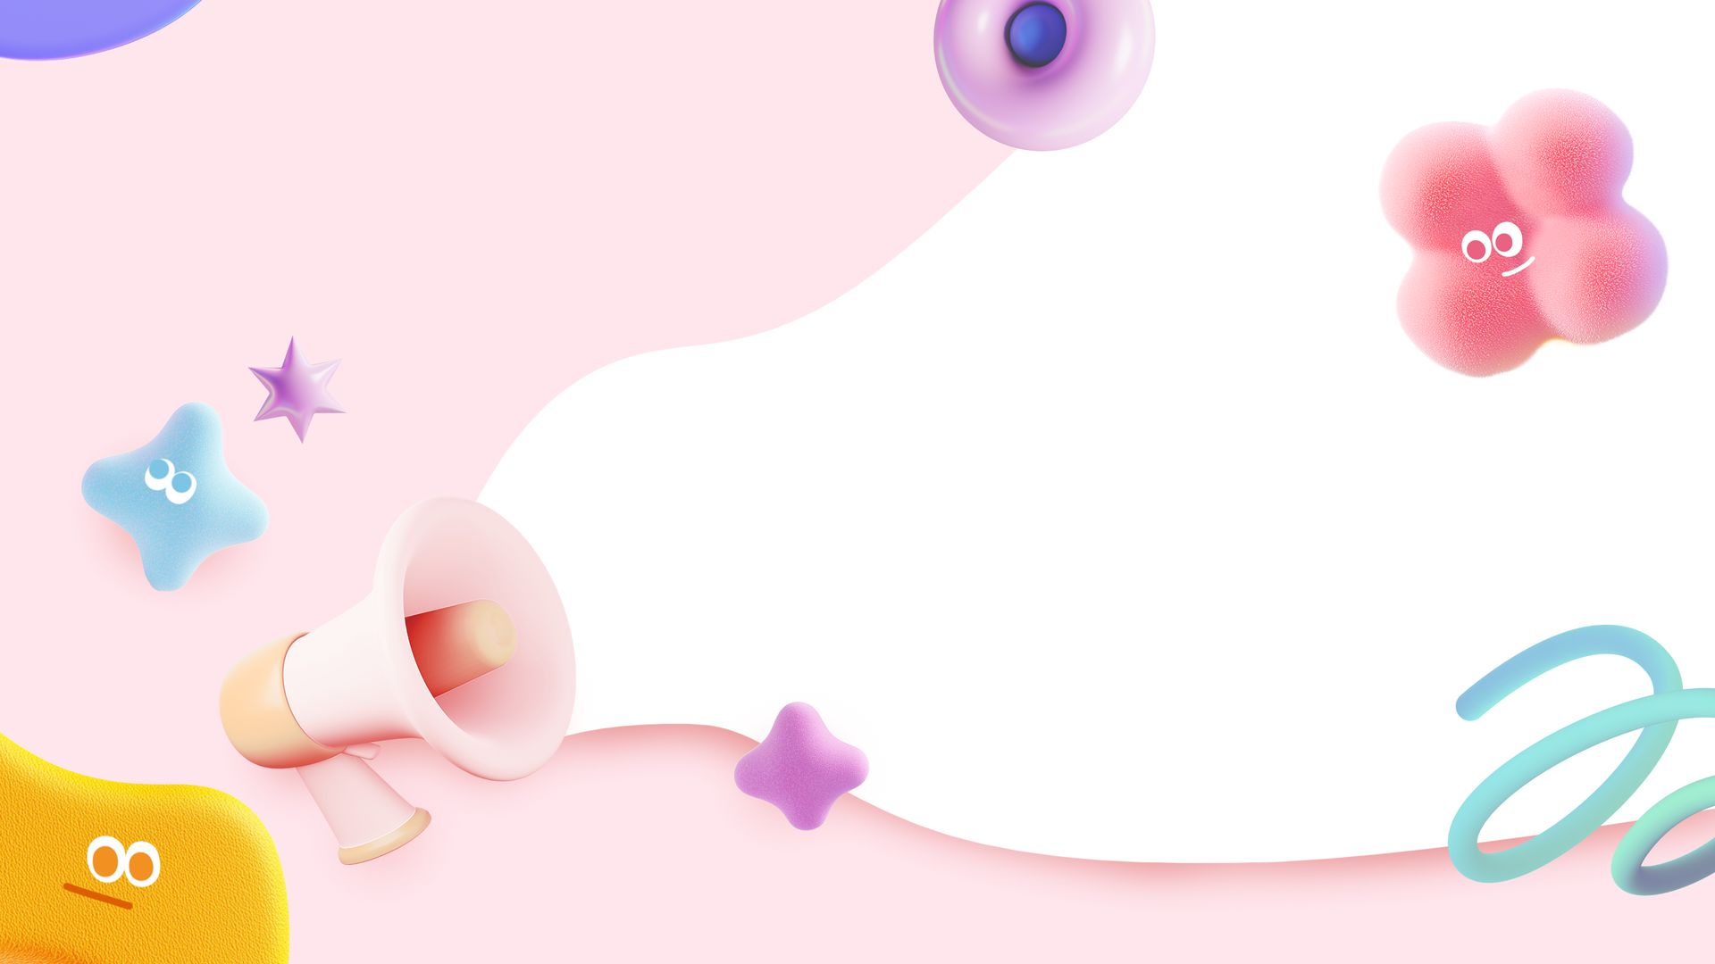
Smart Lyric Brainstorming
Lyric Generation
AI platforms such as ChatGPT and LyricStudio can generate lyric ideas, rewrite lines to fit rhythm and rhyme, and suggest variations for hooks and verses.

Slide 10
03
PART
Produce & Design

Slide 11


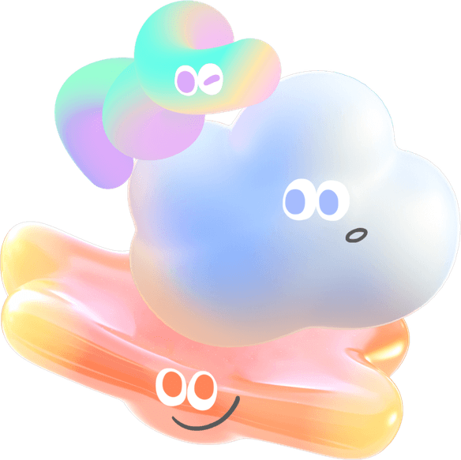
AI Mixing and Mastering
Automated Audio Cleanup
One-Click Mixing
AI tools like iZotope Neutron and Waves Clarity clean up audio by removing noise, hum, and unwanted reverb, improving overall sound quality.
AI-powered mixing tools provide quick and effective solutions for balancing levels, applying EQ, and adding compression to tracks.

Slide 12
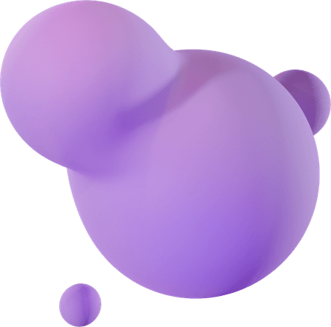

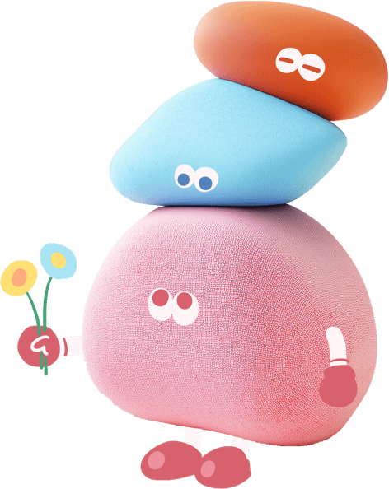
Generative Sound Design
Synth Patches
Drum Textures
Ambient Layers
AI can create custom synth patches and sound textures, enabling unique and innovative sound design.
AI tools generate drum textures and patterns, adding depth and variety to electronic music production.
AI assists in crafting ambient soundscapes, enhancing the overall atmosphere and mood of a track.

Slide 13
04
PART
Practice & Perform

Slide 14
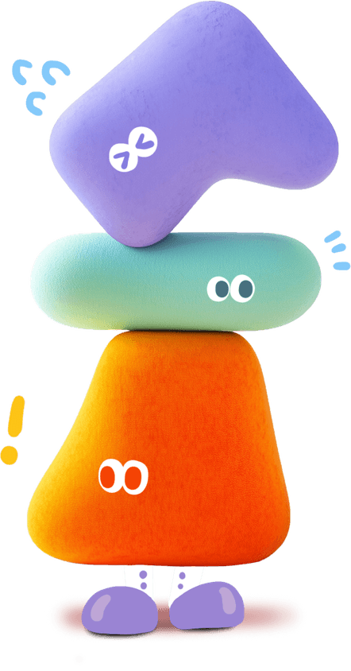
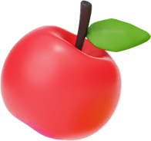
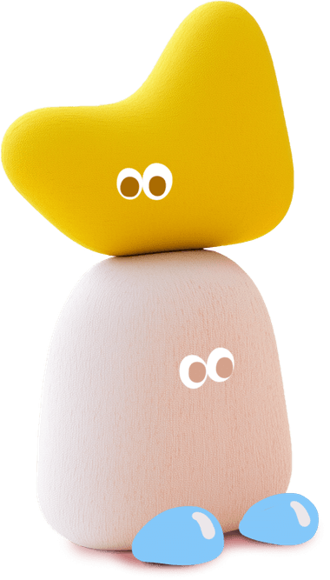
AI Practice Coach
Personalized Drills
Platforms like Yousician and Moises.ai create personalized practice routines and provide real-time feedback on pitch and rhythm, enhancing skill development.

Slide 15



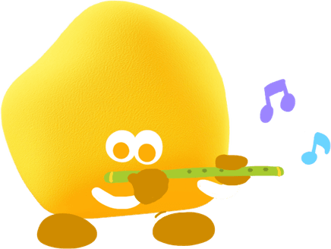



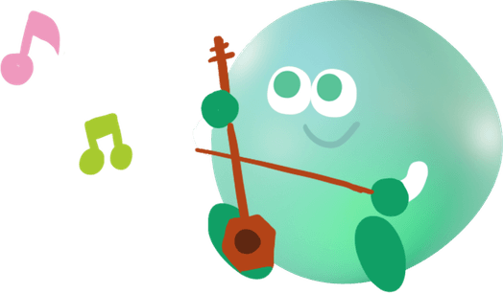
Audio to MIDI
Chord Identification
AI tools convert audio recordings into MIDI files, making it easier to analyze and edit musical performances.
AI identifies chords, key signatures, and song structures, aiding in the analysis and understanding of musical compositions.
Stage-Ready Transcription
Sheet Music
Lead Sheets
AI can transcribe audio into sheet music, providing a written record of compositions and performances for reference and study.
AI generates lead sheets quickly, providing a concise representation of a song’s melody, chords, and lyrics.

Slide 16
05
PART
Brand & Promote

Slide 17
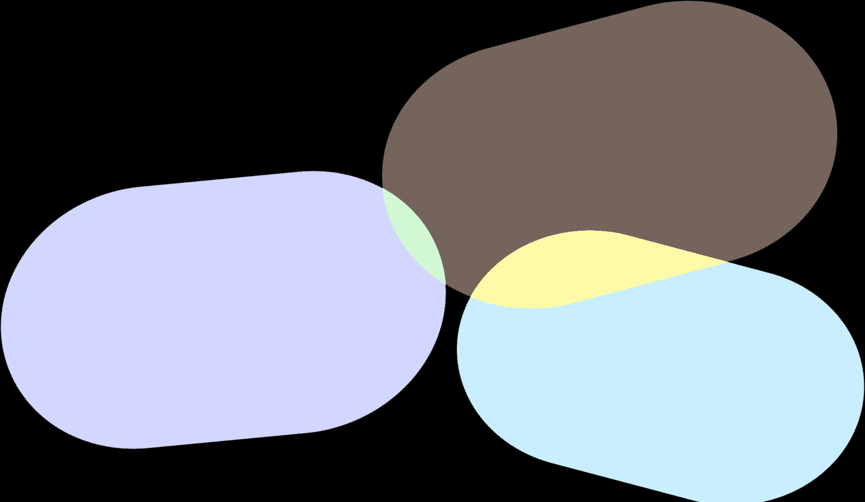
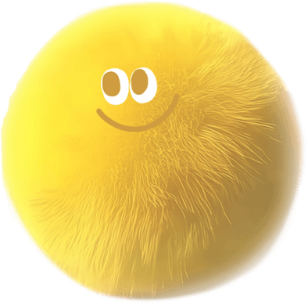
AI Content for Musicians
Press Releases
AI assists in drafting press releases and artist bios, ensuring professional and consistent communication with the media.
Social Media Captions
AI tools like ChatGPT and Copy.ai generate engaging social media captions and posts, helping musicians maintain an active online presence.
Tour Announcements
AI helps create promotional plans and tour announcements, streamlining the marketing process for live performances.

Slide 18

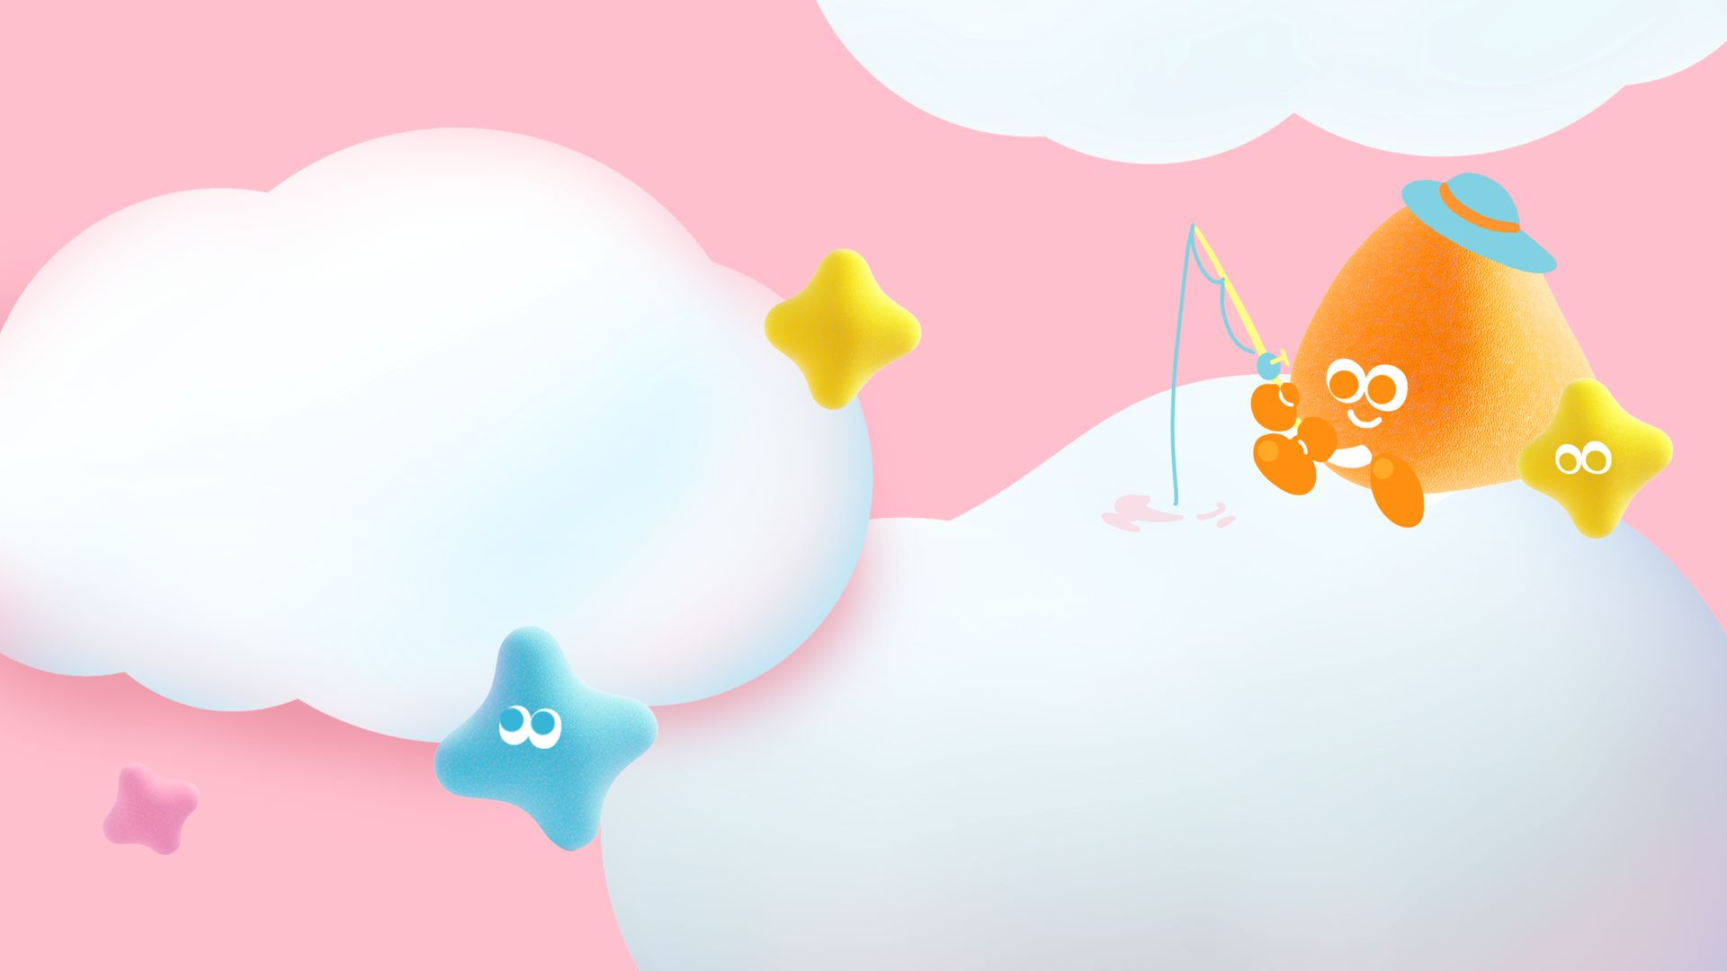
Visuals & Release Campaigns
Album Art
AI tools such as Canva AI and Rotor Videos design album art and logos, providing visually appealing graphics for music releases.
Release Timing
Platforms like Spotify for Artists offer AI-driven insights to help plan optimal release dates and fan engagement strategies.

Slide 19
06
PART
Workflow Audit

Slide 20

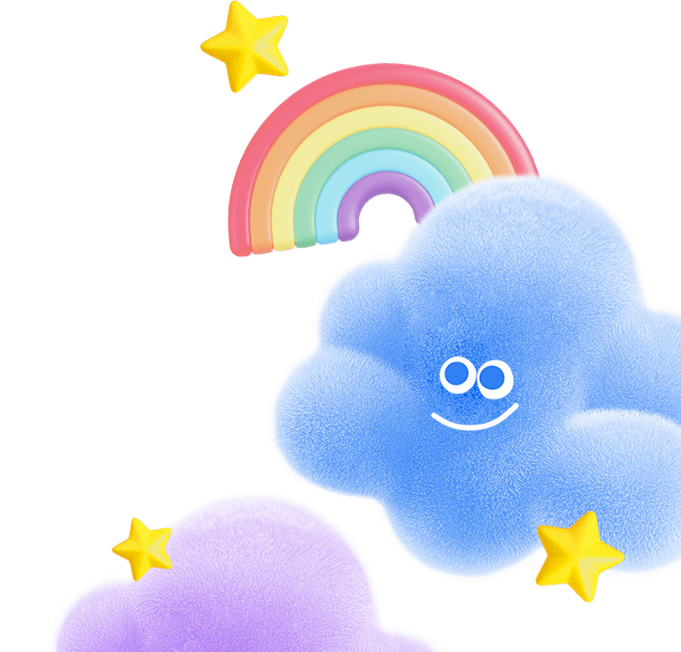
1
Identify Tasks
2
Evaluate Criteria
Map Your Repetitive Tasks
List 5–7 recurring tasks in your music workflow, such as mixing, lyric writing, practice scheduling, and social media posting.
Score each task based on criteria like repetition, technicality, time consumption, and detail intensity to identify AI integration opportunities.
3
Flag for AI
4
Prioritize Integration
Tasks meeting two or more criteria are strong candidates for AI integration, helping to streamline your workflow.
Create a matrix linking flagged tasks to specific AI tools to prioritize high-impact integration points for immediate benefits.

Slide 21

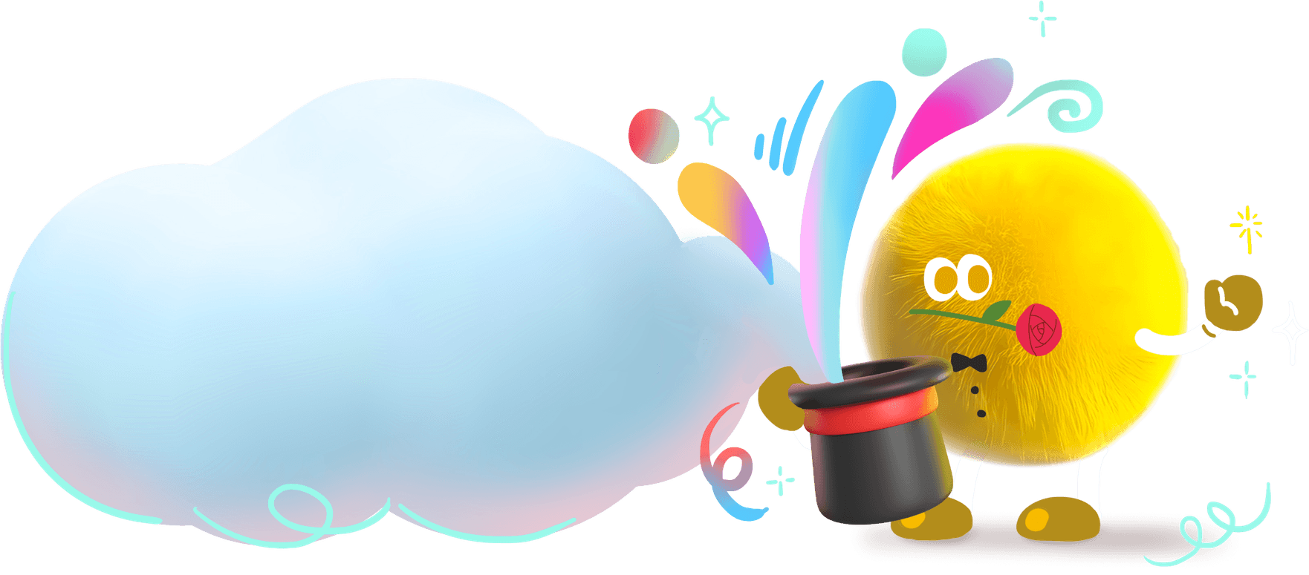

Prioritize High-Impact AI Wins
Quick Victories
Choose tasks like automated mastering or social media copy generation for quick AI integration wins that free up time for creative work.

Slide 22
07
PART
Practice Labs

Slide 23
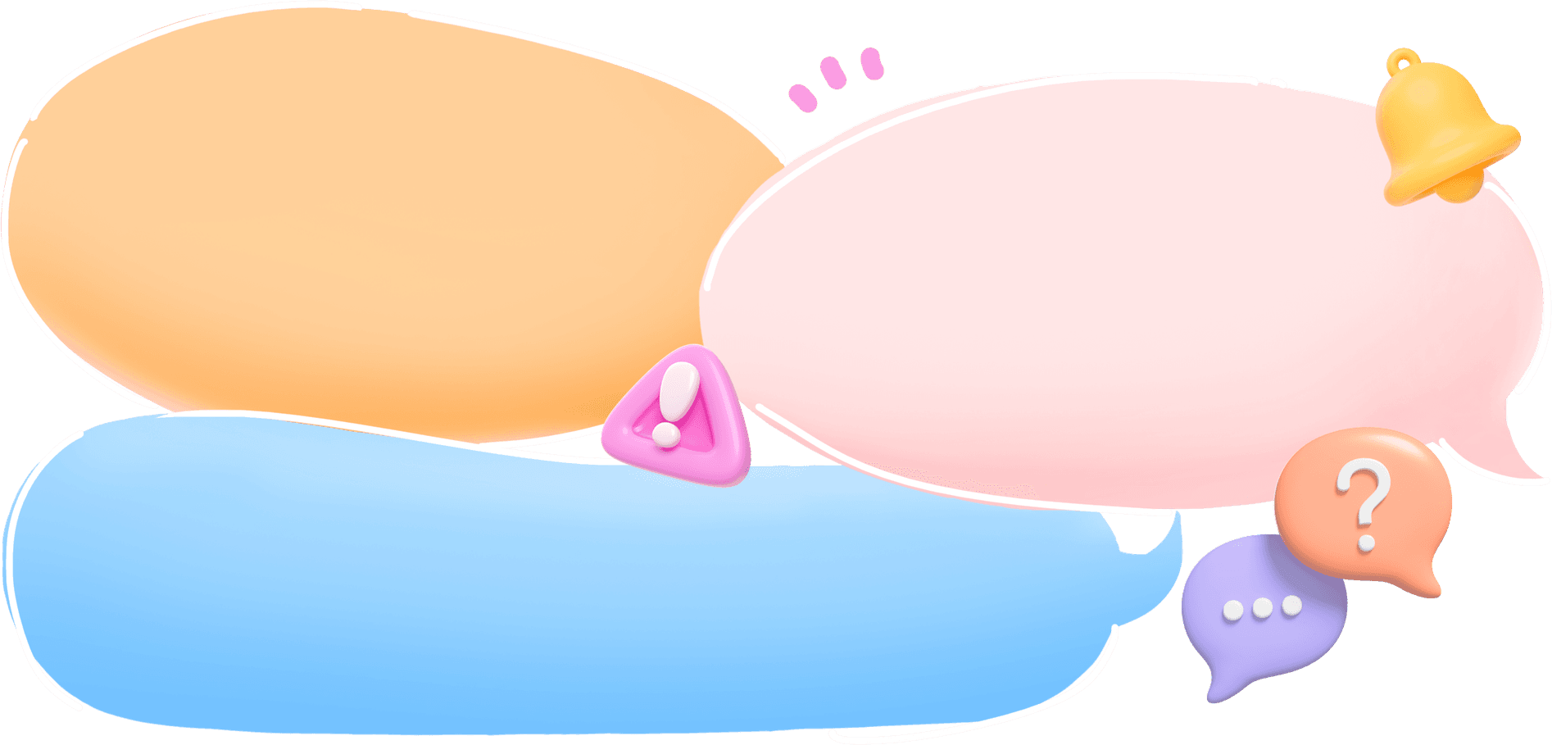
Lab One: Compose a Pop Hook
Chord Progressions
Use AI tools like Suno or AIVA to generate chord progressions tailored to your desired pop style, providing a solid harmonic foundation.
Lyric Variations
Experiment with AI-generated variations of your chorus lyrics to add energy and freshness to your song.
Melody Hooks
Generate three melodic ideas over the chord progressions to find the perfect hook that captures attention.

Slide 24

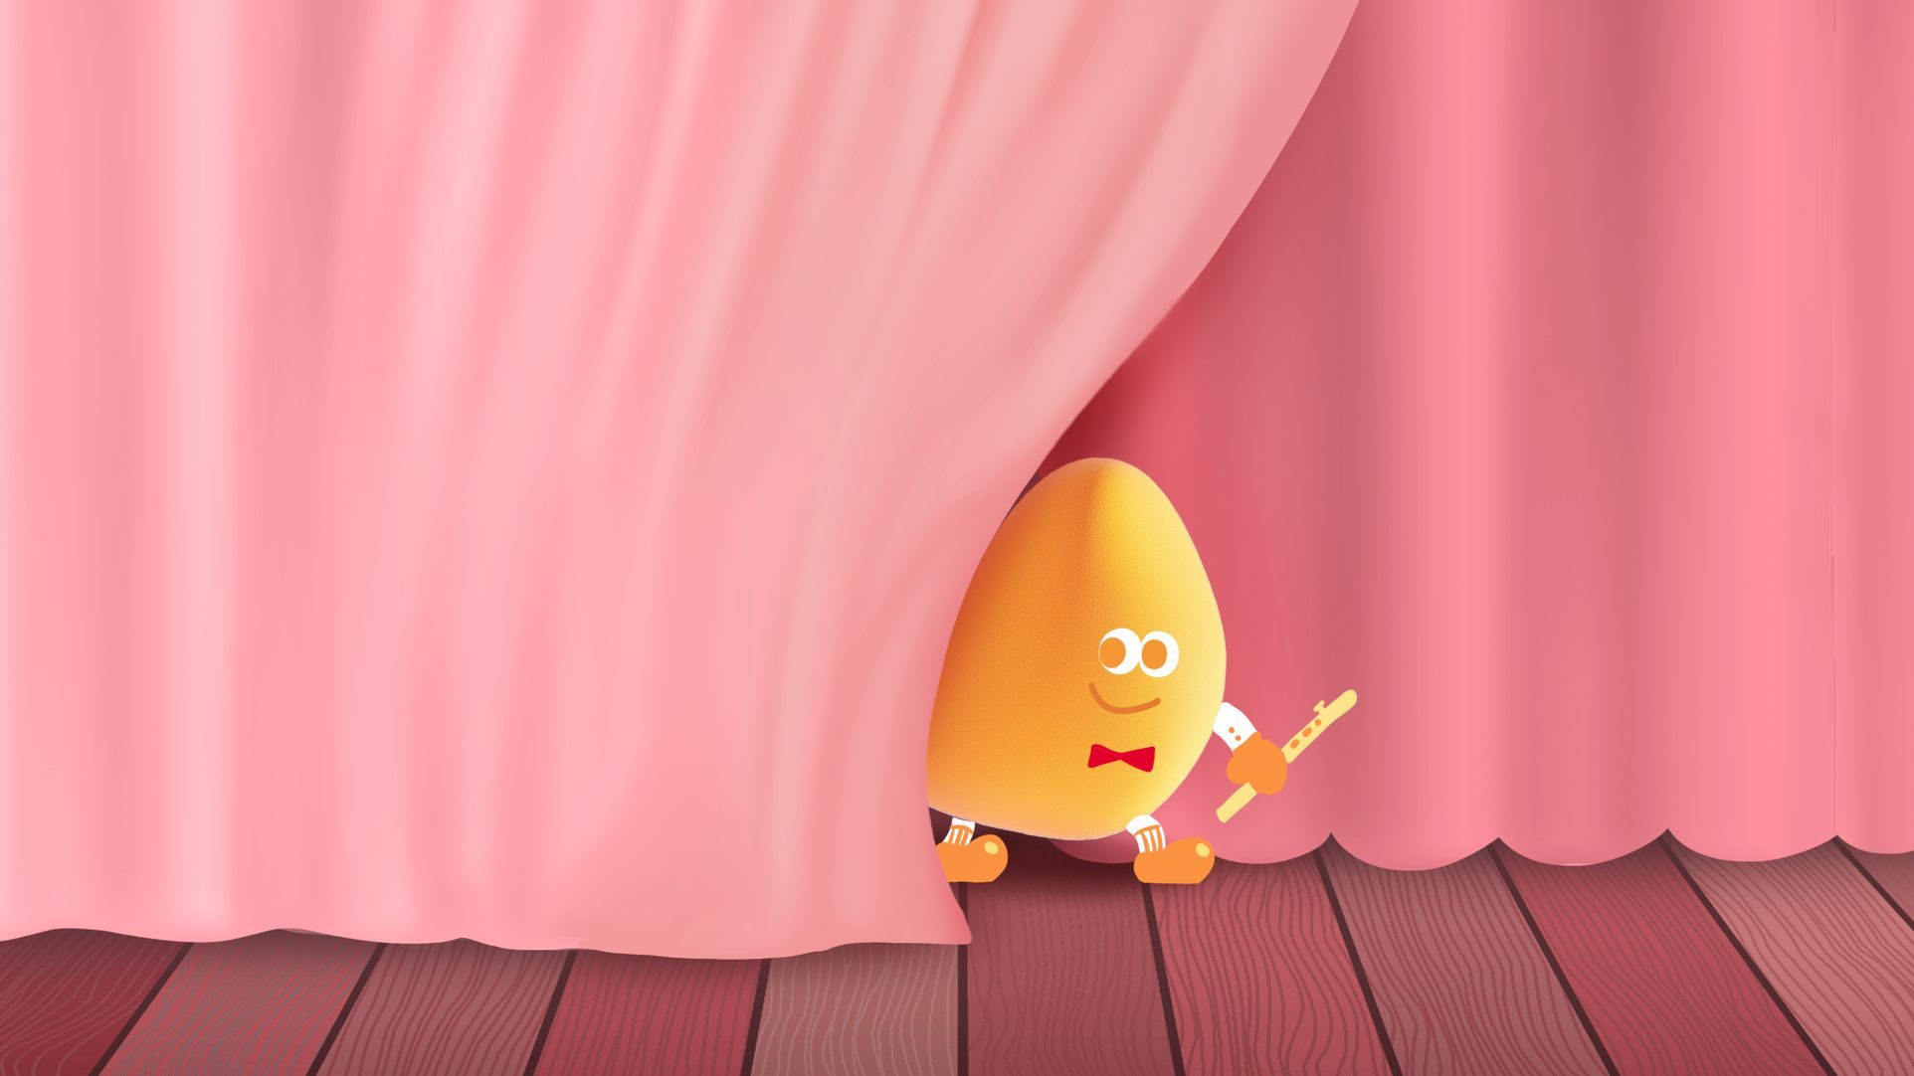

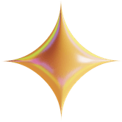
Lab Two: Master a Muddy Demo
Adjust Settings
Automated Mastering
Tweak the suggested settings to achieve a warm, punchy sound, ensuring your demo is ready for professional distribution.
Run your rough mix through LANDR or iZotope Ozone for automated mastering, applying industry-standard EQ and compression settings.

Slide 25


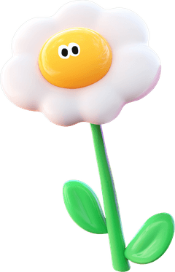

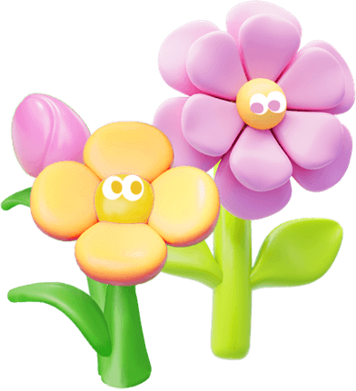

Lab Three: Improv Practice Tracks
Solo Analysis
Backing Tracks
Use AI to analyze your recorded solos and identify key motifs, helping you refine your improvisational style.
Prompt Moises.ai or Melodic to create ii–V–I backing tracks in all twelve keys, providing diverse practice material.
Phrasing Exercises
Rhythmic Precision
Generate five exercises focused on improving phrasing and expression in your jazz improvisation.
Practice with AI-generated tracks to improve rhythmic precision and timing in your improvisational performances.

Slide 26
08
PART
Ethics & Recap

Slide 27
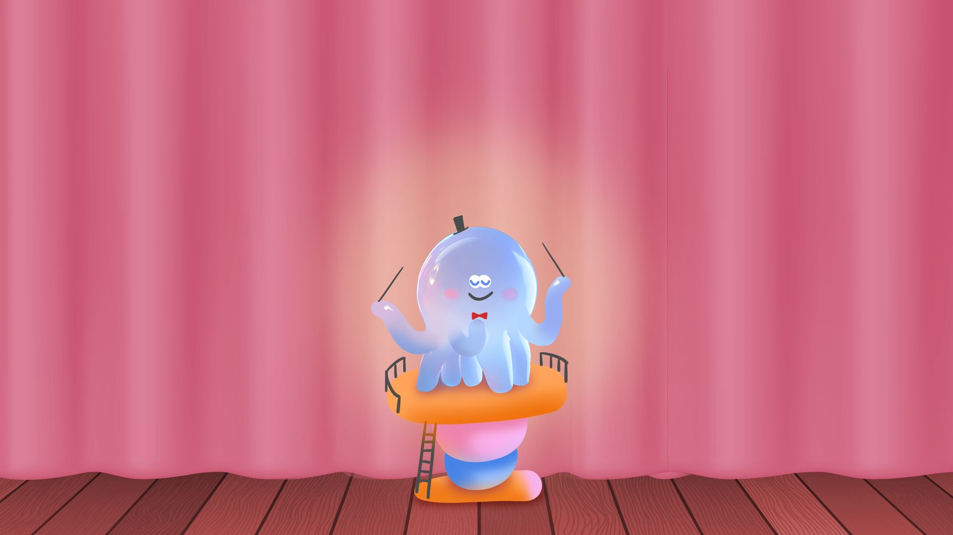
When NOT to Use AI
Expressive Performance
Lyrical Storytelling
Avoid AI for performances that require emotional expression and personal connection with the audience.
Do not rely on AI for storytelling in lyrics that demand personal experience and emotional depth.
Improvisational Feel
Authenticity
Skip AI when improvisation and spontaneous creativity are crucial, as these elements are deeply human.
Ensure AI does not dilute authenticity, style, or cultural respect in your music, maintaining artistic integrity.

Slide 28
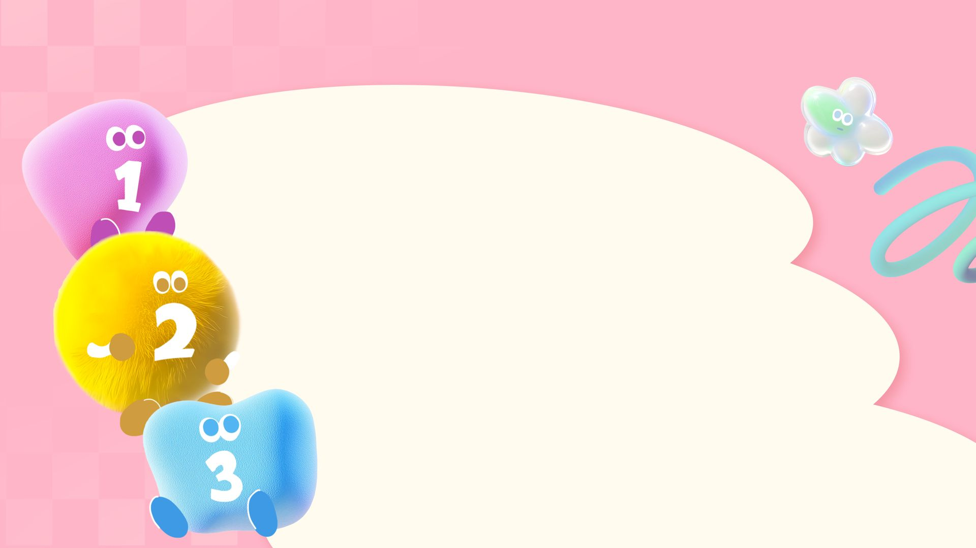
Key Takeaways & Next Steps
AI Strengths
AI excels at technical, repetitive, and promotional tasks, acting as a creative collaborator rather than a replacement.
Human Oversight
Maintain human oversight to ensure AI tools enhance your unique artistic voice and creative vision.
Iterative Integration
Start with one task, apply the AI tool, iterate on the results, and gradually expand AI adoption in your workflow.

Slide 29
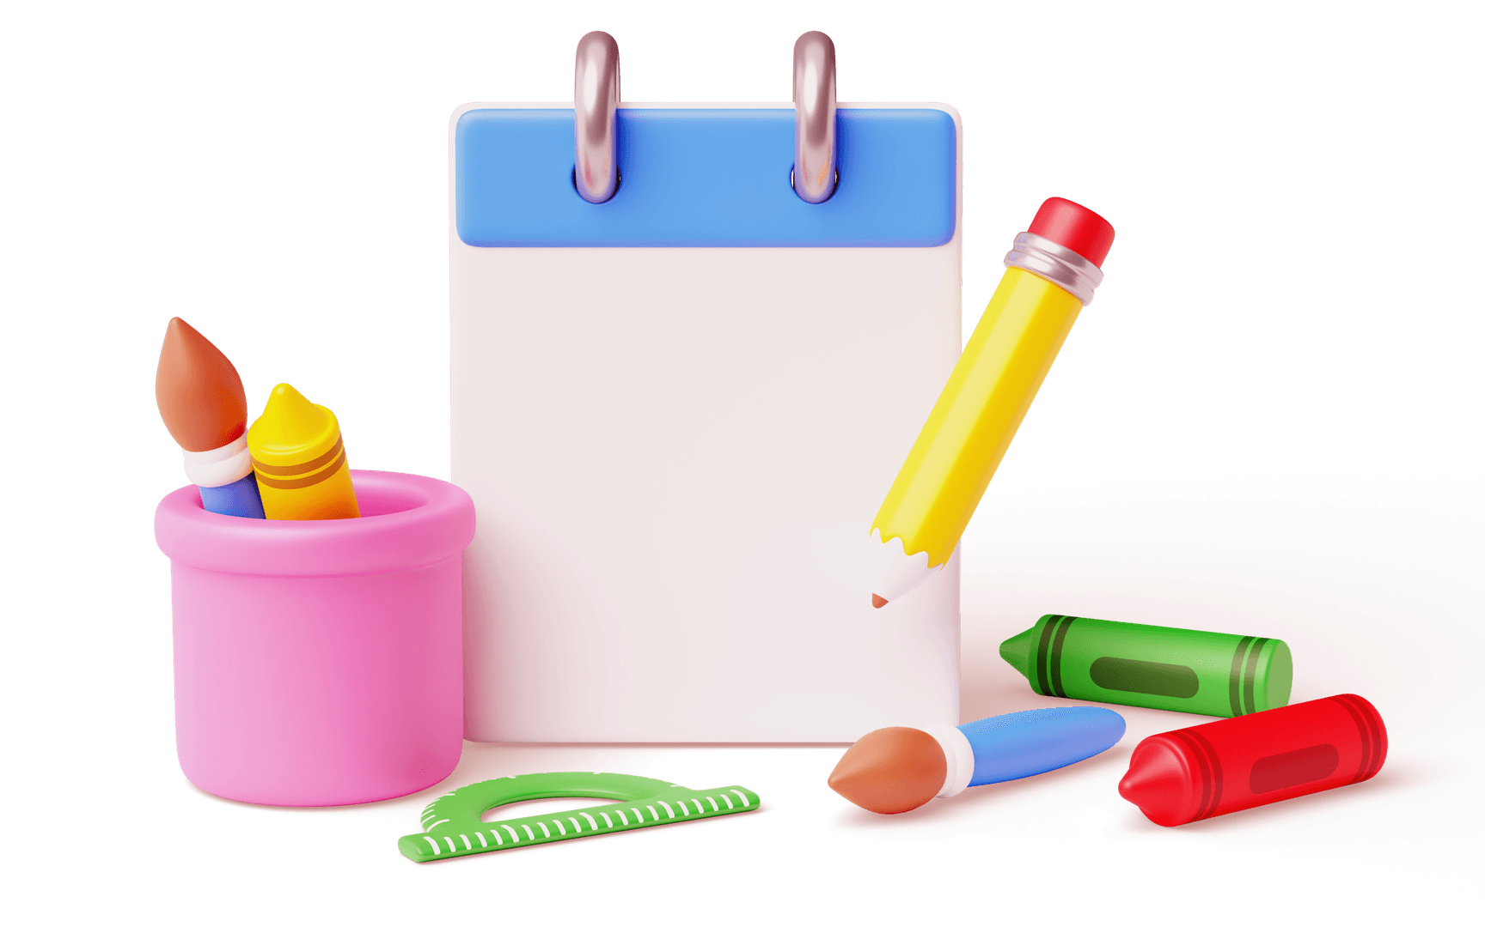



Cheat Sheet & Resource Links
Access a one-page cheat sheet listing AI strengths, tool names, and use cases, along with links to tutorials, communities, and practice resources.
Quick Reference

Slide 30

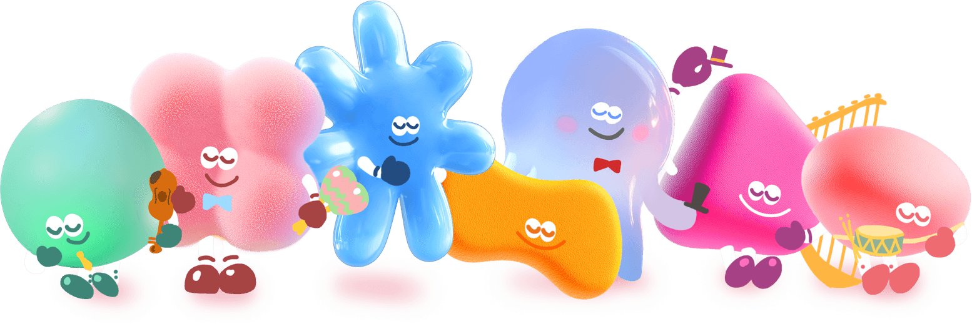
THANK YOU
Sean Wong
2025/01/01

